Slide 1
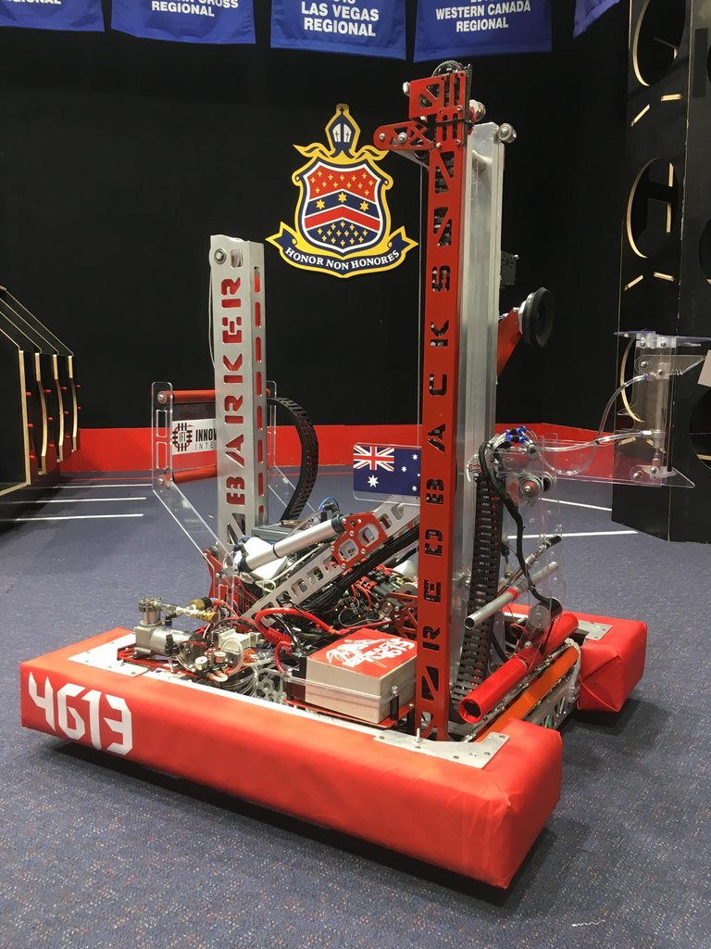

Functions and Access Operators
Overall Topic: Hardware
Basic Workshop 1.2

Slide 2

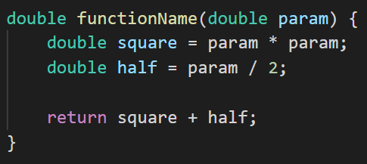
Introduction to functions
What is a function?
A block of code
With a name
That takes inputs
Does something
And may produce an output value
Of a specified type
5
1
2
1
2
3
3
4
5
4

Slide 3
Breaking it down – the function header
The function header is the first line of any function. It defines
The name of the function
The input parameter types and names
The output (return) type
1
2
3
1
2
returntype functionName(datatype param1, datatype param2)
3

Slide 4
Breaking it down – the function body
The function body is the code between the opening and closing braces {}. It defines
What the function does
What value the function returns as an output
Convention note:
Any line of code within braces {} is indented with a single tab, displayed as 4 spaces.
1
2
1
2

Slide 5

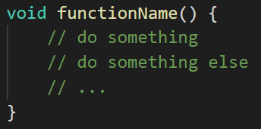
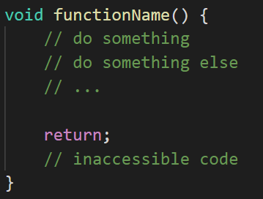
The void returntype
What if we don’t want to return a value? The void type
Indicates the function does not return a value
Cannot be used as a type for a regular value
The return keyword can still be used to exit the function, but is given no value.

Slide 6
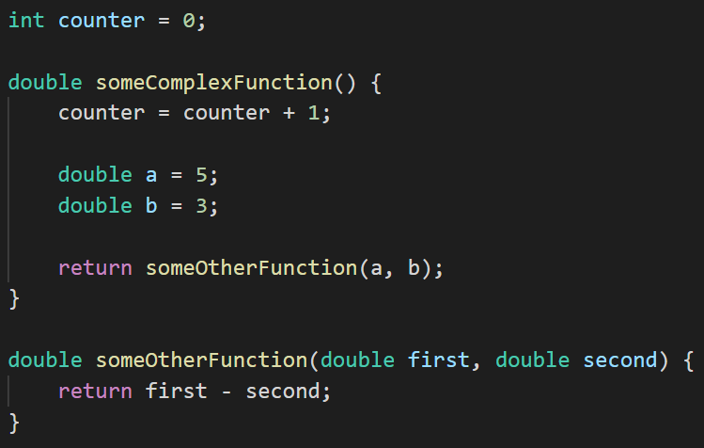
Programming within functions
Outside a function, we can only create variables. Inside a function, we can
Assign new values to existing variables
Create variables that only exist within the function
Run other functions

Slide 7
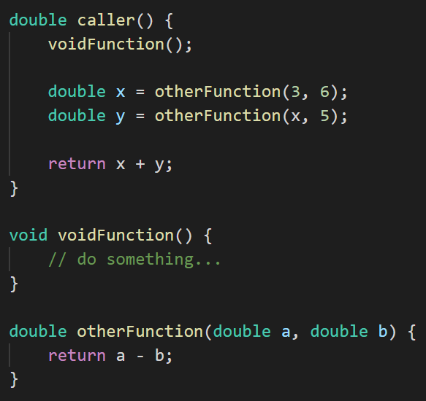
Calling a function
To run/“call” a function
We use its name
Followed by parentheses ()
Containing values for any parameters
We can then treat its return value like any other value.
What is the return value of caller()?

Slide 8
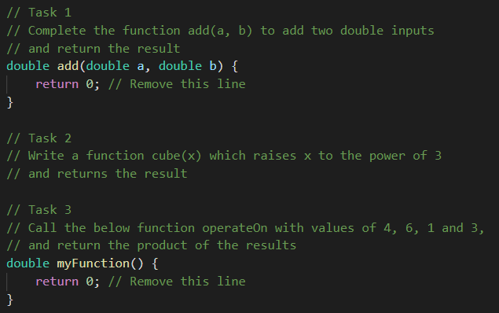

Your turn
Pull the git repo at https://github.com/ArachneTutorials/Tut-B1-Hardware and open lesson 2 in Visual Studio Code.
In src\main\java\lesson\functions\tasks\Tasks.java, complete section 1:
You can test your solutions with some short tests by right-clicking on the TestSection1.java file and selecting “Run”.

Slide 9
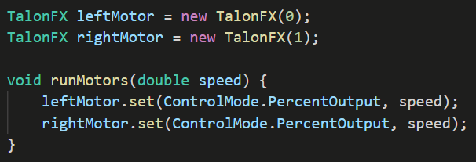
The dot operator
The dot operator allows us to
Access variables, and
Call functions
from within variables with complex datatypes or other files.

Slide 10

System.out.println()
System.out.println() is an existing Java function used to display values in the console.
We have to use the dot operator to access it, within
A separate file, System.java
A variable within System.java, out
A function within out, println
Then we give it a value to display.
1
2
3
4
1
2
3
4

Slide 11
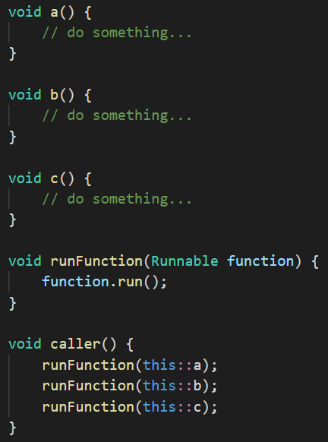
The double colon operator
The double colon operator allows us to access references to existing functions.
Differences to the dot operator:
Only accesses functions
Doesn’t call the function
Must be prefixed with “this” when accessing functions in the same file

Slide 12
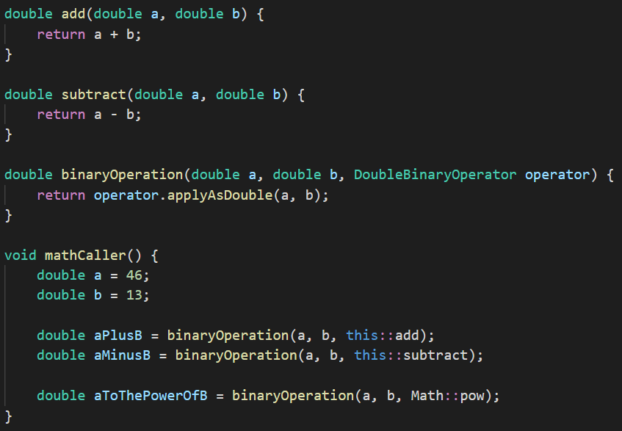
Double colon example

Slide 13
Your turn
In src\main\java\lesson\functions\tasks\Tasks.java, complete section 2.
You can also use the Sandbox.java file in the same folder to experiment with your own code.
You can test your solutions with some short tests by right-clicking on the TestSection2.java file and selecting “Run”.

Slide 14
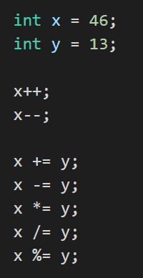
Additional assignment operators
Operator | Results in
x++ | x increases by 1
x-- | x decreases by 1
x += y | x increases by y
x -= y | x decreases by y
x *= y | x is multiplied by y
x /= y | x is divided by y Standard truncation rules still apply
x %= y | x is set to the remainder when it is divided by y

